Slide 1
Inter-Process Communication.

Slide 2
Inter-Process Communication.
Multiprocessors.
Programming multiprocessors systems.
IPC: Mutual exclusion, semaphores,message..
Deadlocks.
Message passing.

Slide 3
Parallelism.
CPU 0
CPU 1
CPU 2
Shared memory
Start Pgm1
Open file 2
Write rec10
Close file 2
End Pgm2
Notes:
Un programme qui effectue différentes opérations
? Possibilité de les distribuer sur plusieurs processeurs ?
? Possibilité de lancer plusieurs fois le (même) programme en parallèle ?
Besoin de gérer la cohérence et la gestion des interruptions…

Slide 4
Flynn Classification.
SISD: one instruction processing one data
SIMD: one instruction processing multiple data ( array of data )
MISD: multiple instruction processing single data
MIMD: multiple instruction processing multiple data

Slide 5
SISD and SIMD.
Instructions
Data
Cu
ALU
ALU
Data
Notes:
Cu Control Unit
ALU Arithmetic Logic Unit

Slide 6
MIMD.
Data
Cu
ALU
Cu
ALU
Data
Notes:
MISD: Multiple Instruction, Single Data: mêmes données traitées par plusieurs processeurs (qui doivent ensuite contrôler le résultat et s’aligner)
– Fault tolerant systems
Space Shuttle
MIMD: Multiple Instruction Multiple Data. Multi-processeurs indépendants.
Architecture typique actuelle

Slide 7
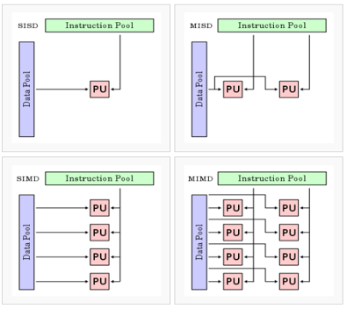
SISD, SIMD, MISM, MIMD…

Slide 8
General purpose MIMD.
Shared memory µ-procs:
use central memory for communication purpose
interconnection methods between procs and memory
Message-passing µ-procs:
a local memory is attached to each procs
direct links to pass data between procs
interconnection methods between procs.

Slide 9
Shared Memory Multiprocs.
Interconnection between procs and memory:
Single bus
System and local bus
Multiple buses
Cross-bar switch
Multi-port memory
Multi-stage networks

Slide 10
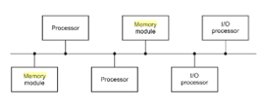
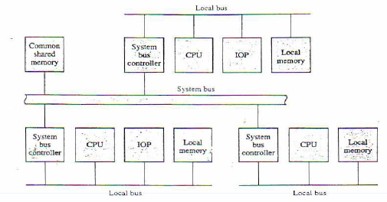
Single bus - System and local bus
Single bus
Possible conflicts
Requires a bus controller
System and local bus
Each processor communicates with own memory and I/O device

Slide 11
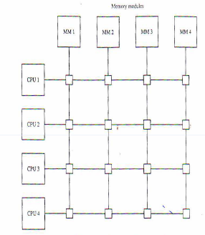
Crossbar switch
Supports simultaneous transfers to all memory modules

Slide 12
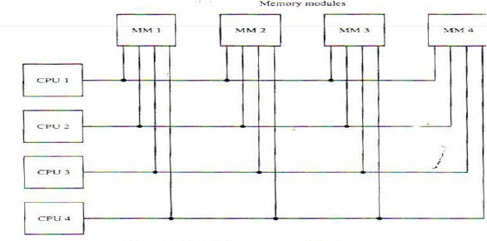
Multiport memory
+ high transfer rates - complex management of memory access conflicts - high number points of connections

Slide 13
Shared memory programming model.
Synchronisation
Process
Process
Process
Process
DATA
Notes:
Shared memory programming model (p.-)
Fondamentalement, le modèle est toujours le même. Différents processus accèdent des données partagées en mémoire centrale (à partir d’un certain niveau) → il faut une synchronisation
99% des ordi actuels utilisent ce modèle : Intel, téléphones, tablettes…)

Slide 14
Message-passing.
Interconnection between procs.
Nearest neighbour mesh
Nodes with n links ( 6, 8,..)
Exhaustive
Cubic
Tree or hierarchical model
Notes:
Clusters, grid computing … emploient le message passing.
(IBM SP2 fin des années 90)
Peut donner des schémas d’interconnexion compliqués, à différents niveaux…

Slide 15
Message-passing programming model.
Messages
Process
Process
Process
Process
DATA
DATA
DATA
DATA
Notes:
Cf . architecture en multiple couche « 3 tiers »
Programmation orientée-object
MQ (IBM, Microsoft, Tuxedo, Message Broker…)

Slide 16
Increased speed – Speedup factor

Slide 17
Efficiency.
Notes:
A partir du speedup, on peut dériver un facteur d’efficacité (n pourcentage)
Dépend du workload de test,
cf. cas du flight simulator (S(4)=1) ➔ Efficiency = 25%
ou du video converter (S(4) = ~4) Efficiency ~100%
Uniquement quand le travail est totalement parallélisable!

Slide 18
Parallel computation and serial section
Procs
Time

Slide 19

Amdahl’s law.
Notes:
Amdahl’s law (p.41)
Tserial = ft Tparallel = (1-f)t
Tserial+Tparallel = t
f = partie non parallélisable
Pour n → infini on tend vers 1/f 50% vers 2 25% vers 4 5% vers 20 (schéma suivant)
Pour f → 0 on est directement proportionnel à « n »

Slide 20
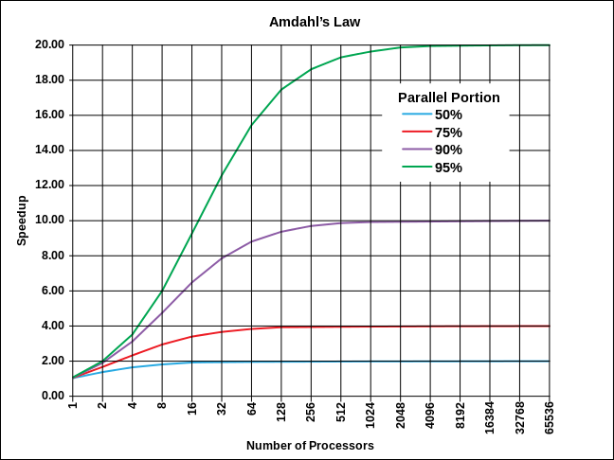
Speed-up against n procs.
Notes:
Si 50% du travail est parallélisable, cela ne sert à rien d’avoir plus de 8 processeurs…
Si 80% du travail est //, on ne dépassera pas un facteur 4 Si 90% facteur 10 Si 95% facteur 20 Si 100% purement linéaire

Slide 21
Cheryl Watson tables for IBM mainframes
Notes:
Speedup factor depends on workload type… WAS, OLTP

Slide 22
Parallelism.
Process is a computation performed by a proc with a defined set of inputs/outputs.
Could be a machine instruction
Usually a sequence of machine instructions
A sequential computation may be performed by concurrent processes after transformation:
by the programmer: explicit parallelism
by the compiler: implicit parallelism

Slide 23
Explicit parallelism.
Main program
Fork
Fork
Fork
Join
Join
Join
Notes:
Cf. cours de programmation

Slide 24
Implicit parallelism: Bernstein’s conditions.
I₁∩O₂ = Ø ; I₂∩O₁ = Ø ; O₁∩O₂ = Ø
Input i
Output i
Process i
Input j
Output j
Process j
Notes:
Les compilateurs vérifient ces conditions avant de générer du code parallèle. C’est entre autres pour cela qu’il faut déclarer ses variables, ses fichiers …

Slide 25
Pseudo-parallelism.
Process
C
B
A
Time
A
B
C

Slide 26
Process.
It’s a sequential program in execution:
object code of the program to be executed
data on which the program will execute
resources required by the program
status of process execution
A same program can be executed simultaneously on two procs of the same systems: in two different processes.

Slide 27
Processes.
Create: Attach ( MVS ), Fork (Unix ), Load_and_exec ( MS-Dos )
Execute: Exec
Stop: Detach ( MVS ), Exit ( Unix ), End_prog ( MS-Dos )

Slide 28
Process Status.
Total Elapsed Time = T_{cpu} + T_{ready} + T_{wait}
Running
Waiting
Ready

Slide 29
Critical sections.
Set of processes running simultaneously
Need for:
a way to communicate ( pass data ) -> synchronisation mechanisms
a way to avoid altering simultaneously the same data
A mechanism ensuring that only one process accesses a particular resource at a time is called a critical section.
Notes:
NOTE !!!!! Progress On Click !!!!!!!!!!!!!
Critical sections (p.43 C.)
Dans un système à multi-processus, il est fondamental de
SYNCHRONISER - communiquer entre les processus, gérer les changements d’états (slide précédent)…
Garantir le DETERMINISME, la COHERENCE ! COORDONNER les changements de valeurs…
Pour cela, il faut garantir qu’un seul processus à la fois peut modifier une ressource, et ne soit pas interrompu n’importe quand / n’importe comment !
Sections critiques

Slide 30
Non-determinate.
No assurance that repeated execution of a parallel program will produce the same results.
Mainly due to the absence of critical sections.
Execution results depends of the execution order or the presence of parallel processes !!!
Need to build determinate software.

Slide 31
Synchronisation
Coordinating processes:
Workload is spread on n processes
Final results exploitable after consolidation
Communication through messages or wait/post mechanism

Slide 32
Mutual exclusion.
Concurrent processes.
N processes share same data or same resources
Execution determinate
Critical section mechanism through semaphore or message usage.

Slide 33
Deadlocks
Mutual exclusion
Process Pa uses resource Rb: exclusive use of Rb
Process Pb uses resource Ra: exclusive use of Ra
Process Pa wants to use resource Ra but waits
Process Pb wants to use resource Rb but waits
->Deadlock situation.

Slide 34
Deadlocks.
Ra
Pa
Pb
Rb

Slide 35
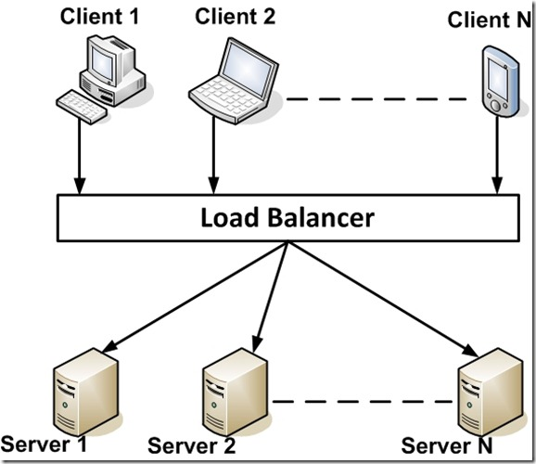
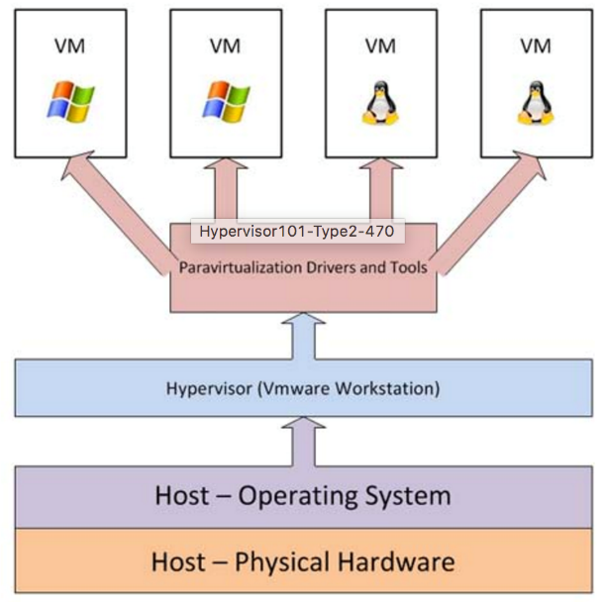
JPC
Farms, Virtual servers…

